Slide 1
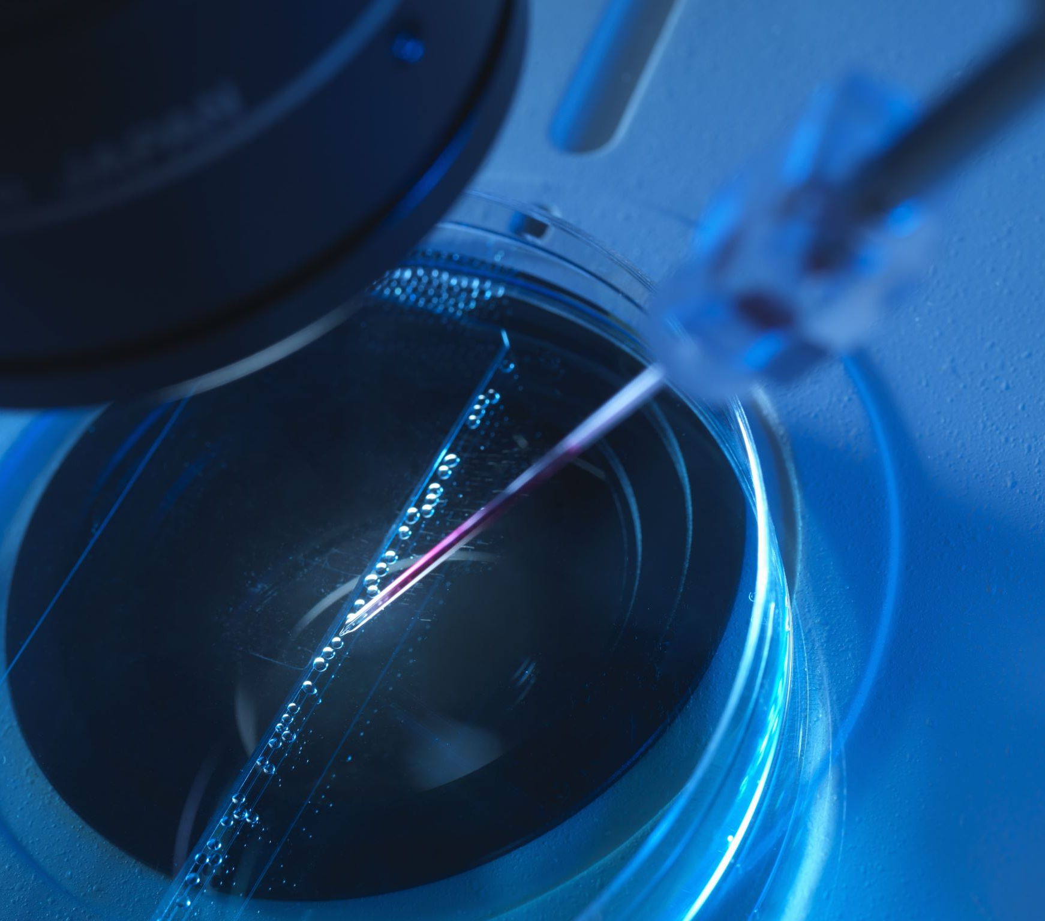
Surgical Video Analysis
AIML Project Elective Term II 2022-23
Week III Mar 18-26

Slide 2
Task Assigned
Task: Surgical Tool Localization
Dataset: m2cai-16 tool locations

Slide 3
This week
YOLO v7 Architecture
Visual Recognition Course Project

Slide 4
YOLO v7
Surpassed all previous YOLO versions in terms on speed and accuracy
Model Parameterization
Model-level
Module-level
Model Scaling
NAS: Automated search of scaling factors
New methods of model reparameterization and model scaling

Slide 5
ARCHITECTURE
E-ELAn

Slide 6
Introduction
Efficiency of an architecture:
Number of parameters
Amount of computations
Computational density
VoVNet Architecture Model analyzed the effect of input/output channel ratio, branches in the architecture and element-wise operation on the speed of the architecture
ELAN and E-ELAN

Slide 7
VoVNet
Deep CNN architecture for image classification
Addresses CNN issues like vanishing gradient and spatial info loss during down sampling
Uses Vector of Volumes approach - Input feature maps as volumetric tensors
Uses residual connections between convolution layers

Slide 8
Towards E-ELAN
CSPVoVNet
Analyzes the gradient path
Makes inferences faster and more accurate
ELAN
Efficient Layer Aggregation Network
By controlling the shortest longest gradient path, a deeper network can learn and converge efficiently
E-ELAN
Extended ELAN
Developed based on the ELAN architecture

Slide 9
E-ELAN
Uses expand, shuffle and merge cardinality
Achieves continuous enhancement of learning ability
Architectural change at computational block only, transitional block is left as it is.

Slide 10
Strategy of Architecture Change
Group convolution to expand the channel and cardinality of computational block
This group parameter(g) and channel multiplier are applied to all computational layers
Output feature maps of the computational blocks are shuffled into g groups and concatenate
These g groups are added to perform merge cardinality resulting in the final feature map

Slide 11
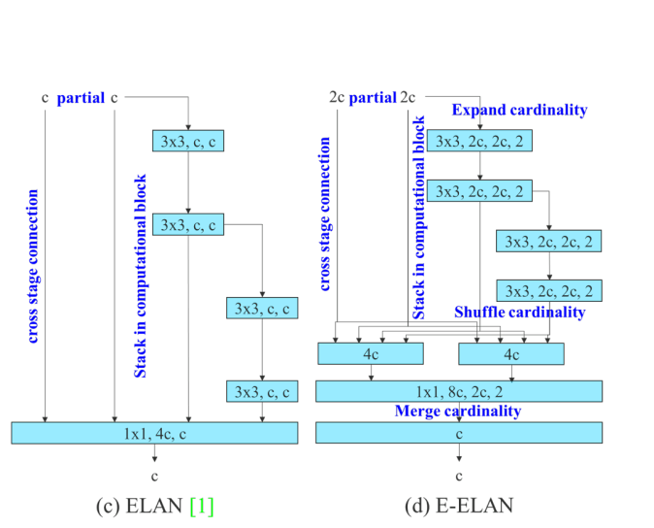
Extension of ELAN

Slide 12
VR Course Project
Question 4 in Report

Slide 13
Next Week..
Lapses (if any) under YOLO v7 architecture
YOLO v7 loss function
Training bag-of-freebies
Concluding my understandings of YOLO v7

Slide 14

THANK YOU

